Slide 1



Hanbok Dress up Game
Android study

Slide 2
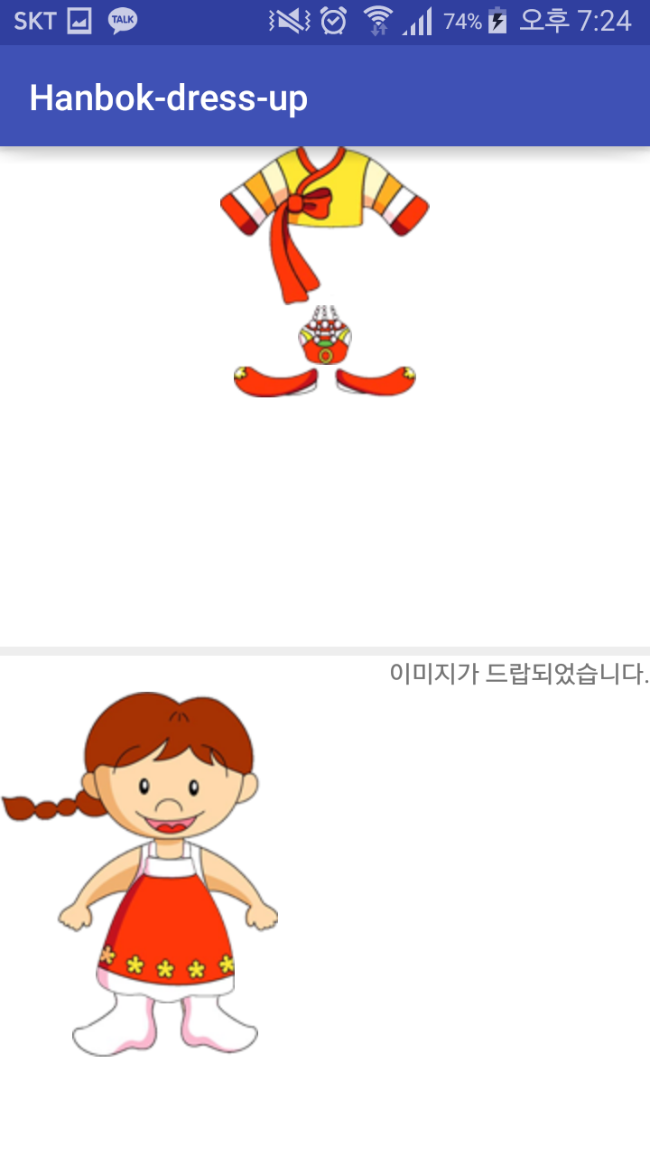
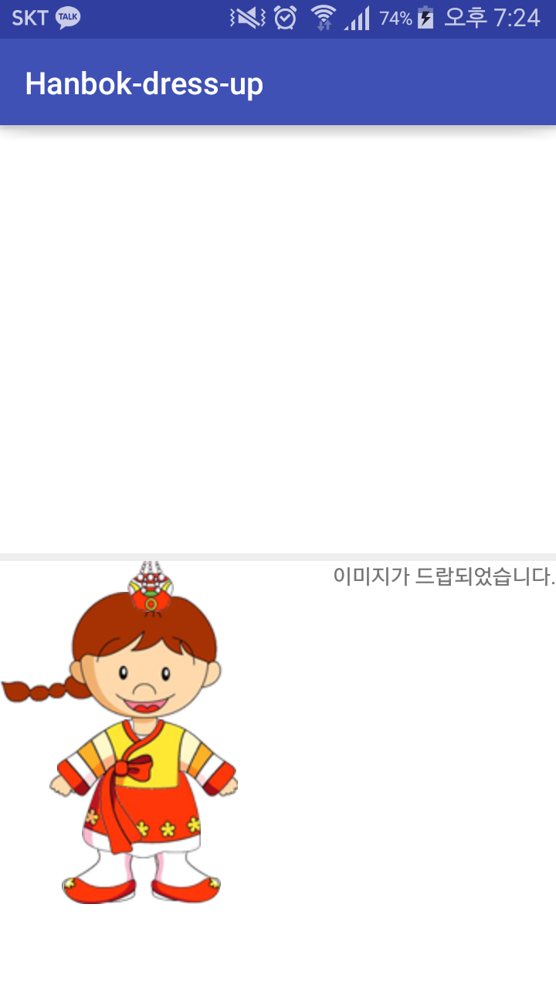
Goal

Slide 3
Callback method

Slide 4

Method of Toast class
Event occurs > Listener response > correspond callback method is called
View class
interface
callback method
Mom: Chulsu, Please come back home by PM 6:00
What time is it now?
It’s 4:00
It’s 4:30
It’s 4:38
It’s 5:01
Please don’t ask me again ☹

Slide 5

Method of Toast class
Event occurs > Listener response > correspond callback method is called
View class
interface
callback method
Mom: Chulsu, Please come back home by PM 6:00
Please tell me at PM 6:00
OK~☺
event
callback method

Slide 6
OnLongClickListener

Slide 7
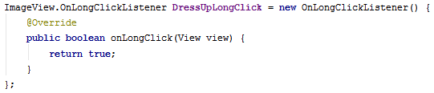
Method of OnLongClickListener interface
@override
OnLongClick(View v) // abstract boolean

Slide 8
OnDragListener

Slide 9
Method of OnDragListener interface
@override
onDrag (View v, DragEvent event)
// abstract boolean
Whenever you pick-up, move and drop the image,
This Listener will run.

Slide 10
DragEvent

Slide 11
Method of DragEvent class
getAction()
getLocalState()
In drag & drop operation,
get some events

Slide 12


getLocalState()
. . .

Slide 13
Constant of DragEvent class
ACTION_DRAG_STARTED
ACTION_DRAG_ENTERED
ACTION_DRAG_EXITED
ACTION_DROP
ACTION_DRAG_ENDED

Slide 14
getAction()
v = toplinear
event.getAction()
= ACTION_DRAG_STARTED
v = toplinear
event.getAction()
= ACTION_DRAG_STARTED

Slide 15
getAction()
v = toplinear
event.getAction()
= ACTION_DRAG_ENTERED

Slide 16
getAction()
v = toplinear
//default

Slide 17
getAction()
v = toplinear
event.getAction()
= ACTION_DRAG_EXITED
v = bottomlinear
event.getAction()
= ACTION_DRAG_ENTERED

Slide 18
getAction()
v = bottomlinear
event.getAction()
= ACTION_DROP

Slide 19
getAction()
v = bottomlinear
event.getAction()
= ACTION_DRAG_ENDED
v = toplinear
event.getAction()
= ACTION_DRAG_ENDED

Slide 20
Controlling Dynamic View

Slide 21
Do you remember?
Without xml file, we can also make UI components
Button myButton = new Button(this);
RelativeLayout myLayout = new RelativeLayout(this);
myLayout.addView(myButton);
setContentView(myLayout);
myButton.setText(“Press Me”);
myButton.setBackgroundColor(Color.YELLOW);
myButton.setTransformationMethod(null);
PRESS ME
This is dynamic View !

Slide 22



Slide 23
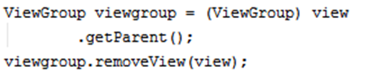
View
Event occurs here

Slide 24
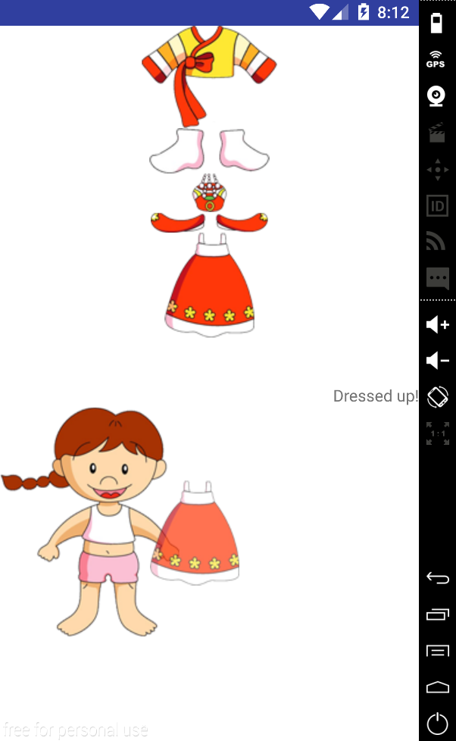
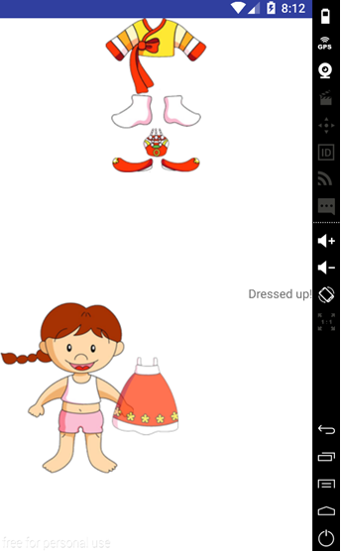

Slide 25
View

Slide 26
startDrag Method

Slide 27

Method of View class
(ClipData, DragShadowBuilder, View)

Slide 28
DragShadowBuilder

Slide 29
DragShadowBuilder
DragShadowBuilder makes some track of the dragged view

Slide 30
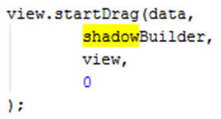
Constructor of DragShadowBuilder class
View.DragShadowBuilder(View view)
startDrag Method of View class
startDrag(ClipData data, View.DragShadowBuilder shadowBuilder, Object myLocalState, int flags)

Slide 31
ClipData

Slide 32

ClipData
The class to store
information in the Drag & Drop View.

Slide 33
ClipData
Constructor of ClipData class
ClipData(CharSequence label, String[] mimeTypes, ClipData.Item item)
ClipData(ClipDescription description, ClipData.Item item)Create a new clip.
ClipData(ClipData other)

Slide 34
ClipDescription

Slide 35
Constant of ClipData class
MIMETYPE_TEXT_HTML
MIMETYPE_TEXT_INTENT MIMETYPE_TEXT_PLAIN
MIMETYPE_TEXT_URILIST

Slide 36
ClipData.Item

Slide 37

ClipData.Item
ClipData.Item is an object that holds the data to be delivered. The data have Text, Url or Intent. ClipData is generated from Through ClipData.Item

Slide 38
ClipData.Item
Constructor of ClipData.Item class
ClipData.Item(CharSequence text)

Slide 39
Log

Slide 40
int d (String tag, String msg)

Slide 41

Download skeleton
https://github.com/daehwa/world-friends-Uzbekistan-android/

